Slide 1


Slide 2

COVID-19 Vaccine Management System

Slide 3
Group Members Introduction
Name: Hamza Ashraf
VU ID: BS170400637

Slide 4

INTRODUCTION OF PROJECT
“COVID-19 Vaccine Management System” is an appointment scheduling system to facilitate the residents with scheduling their COVID-19 vaccine appointments. It will provide on hand information about current COVID-19 situation. The aim of this website is to manage mass vaccination, including vaccine distribution and administration.

Slide 5
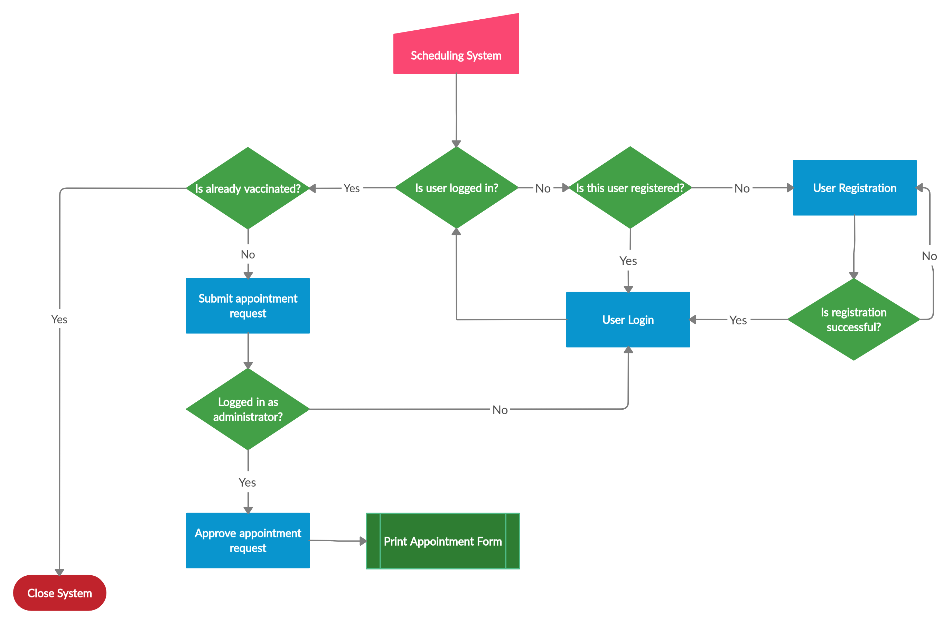
Process Model Diagram

Slide 6
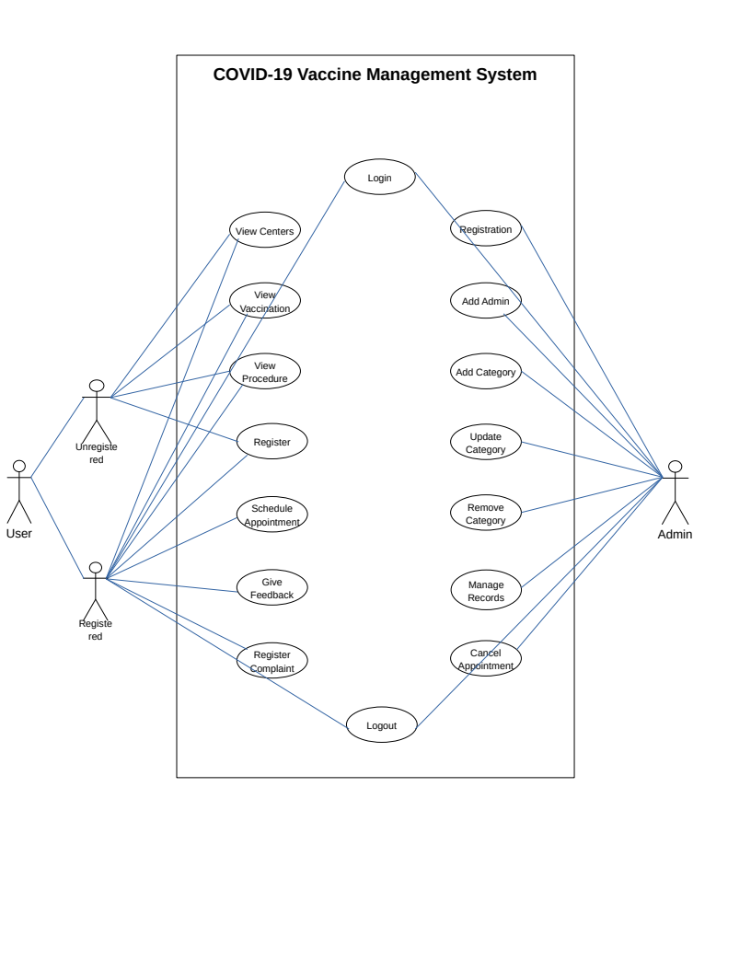
Use Case Diagram

Slide 7
Business Rules Catalog
Users can view the details of vaccination
Users can schedule appointments online
Users can also give feedback
Admin can insert, delete, view and update records

Slide 8
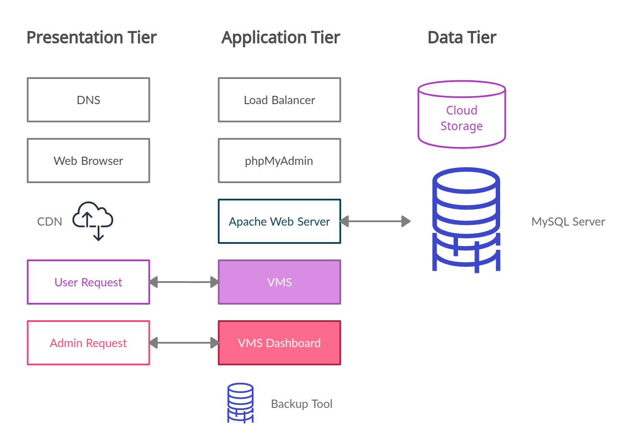
Architectural Design

Slide 9
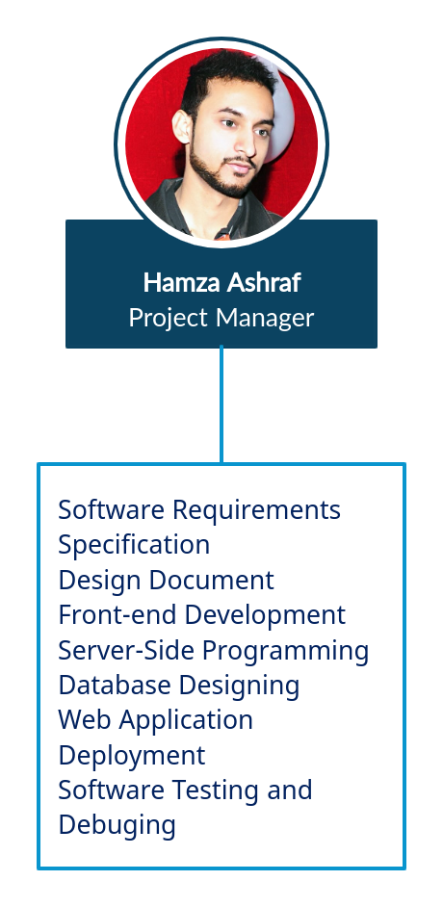
Team Structure

Slide 10
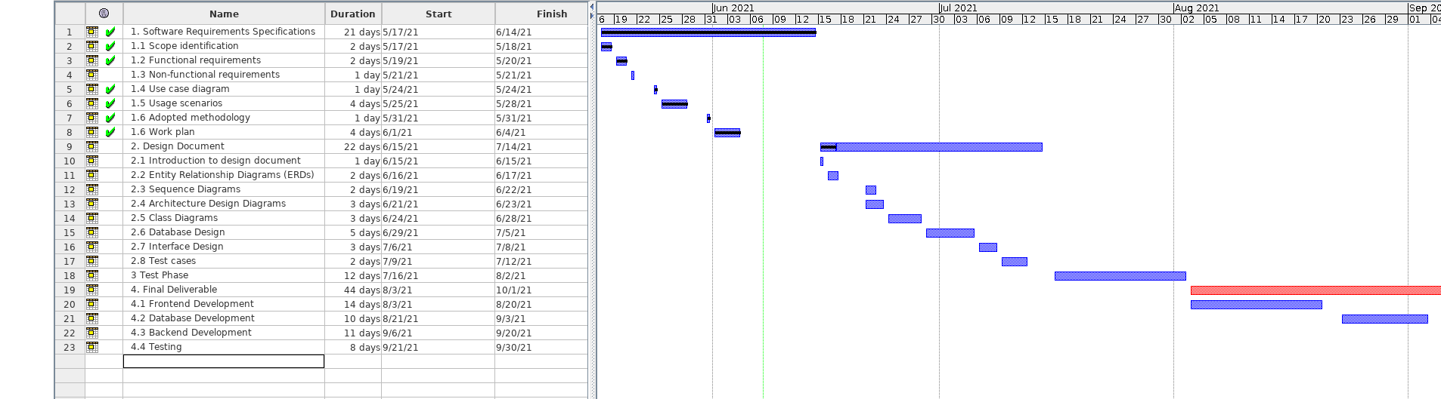
Project Schedule

Slide 11
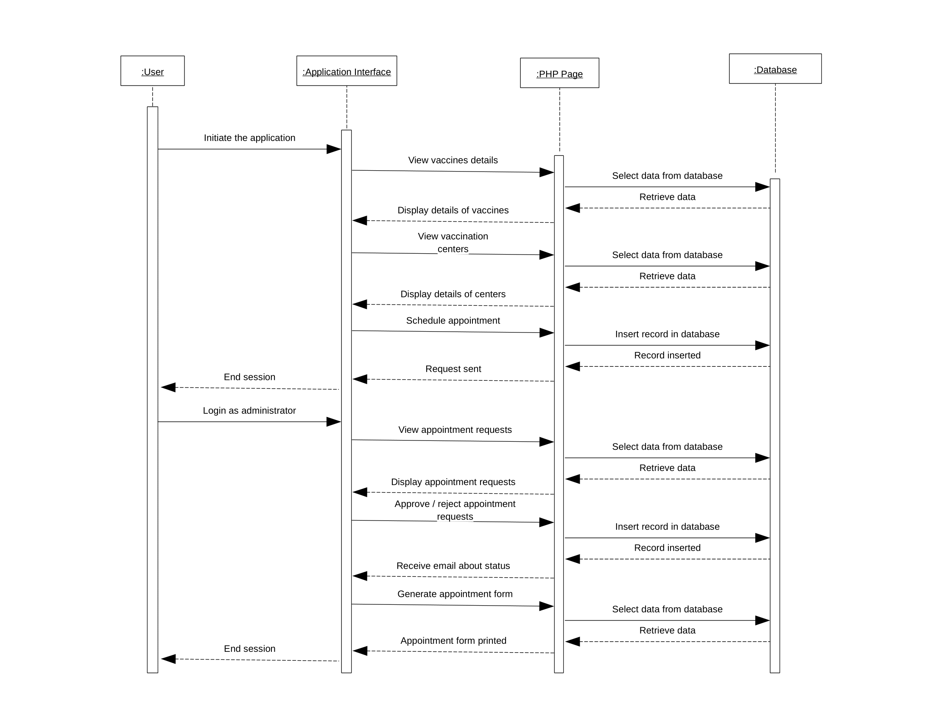
Sequence Diagrams

Slide 12
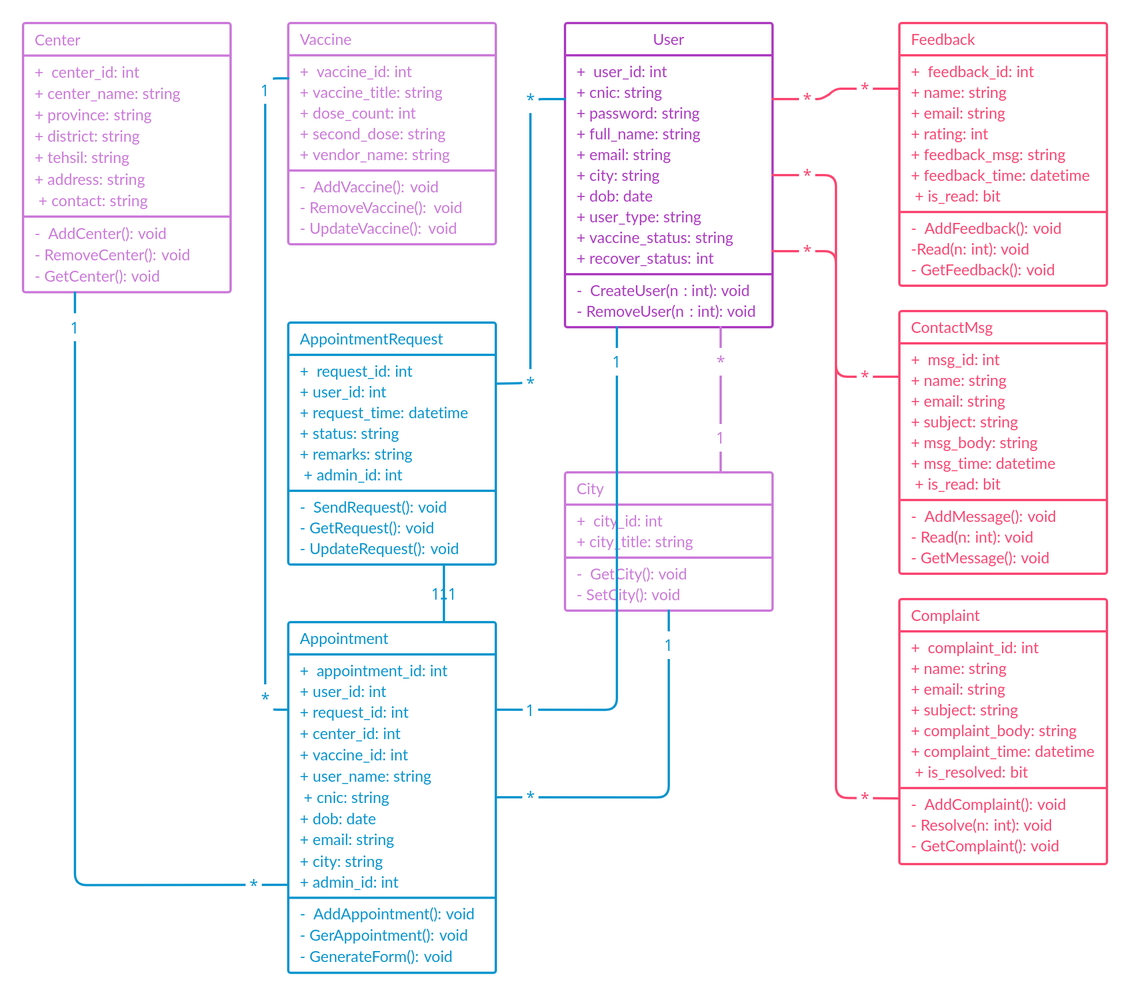
Logical Model/Class Diagram

Slide 13
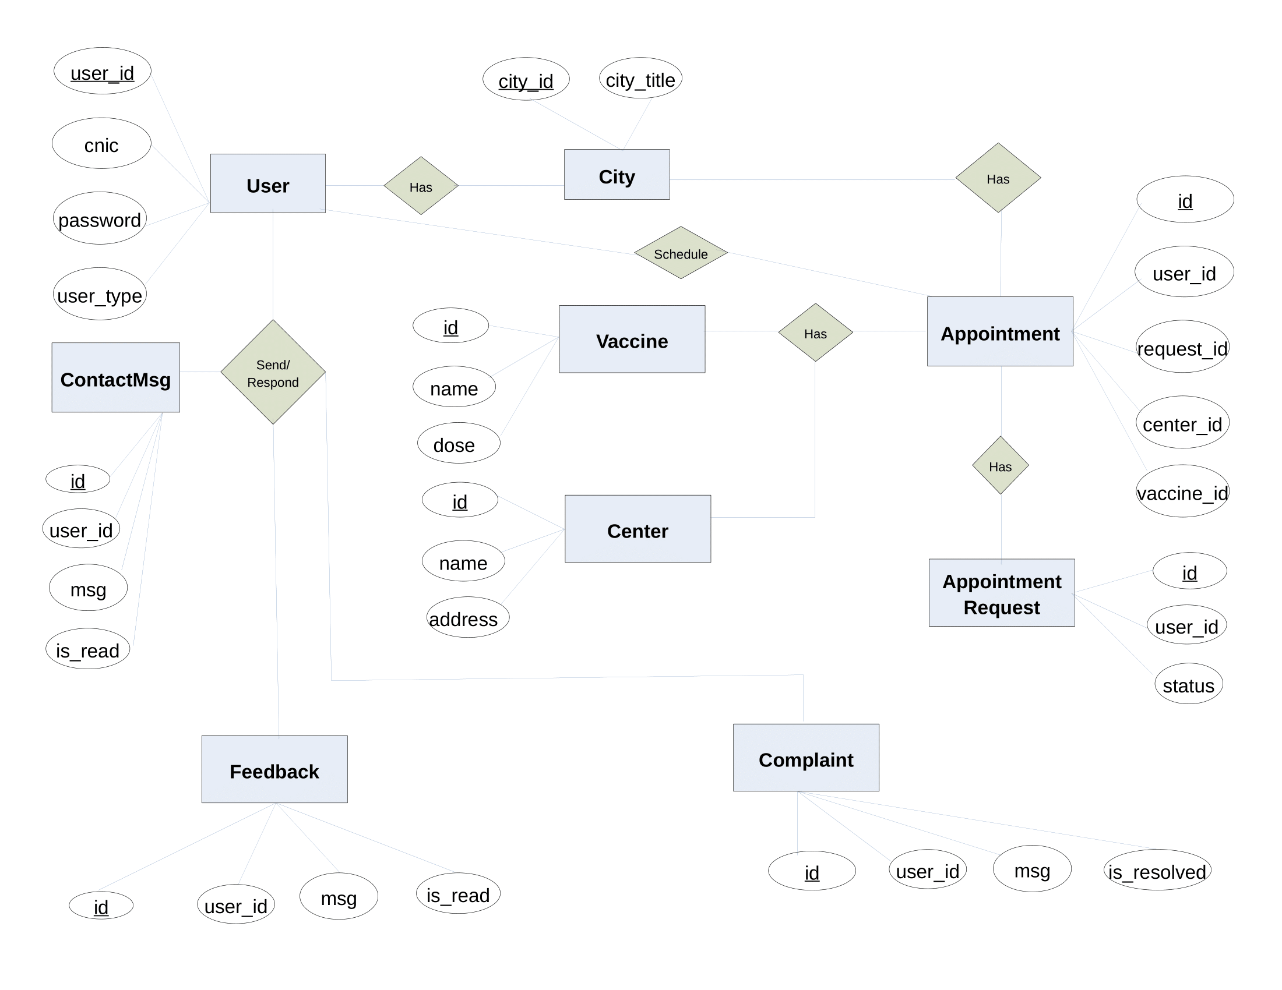
Entity-Relationship Diagram

Slide 14
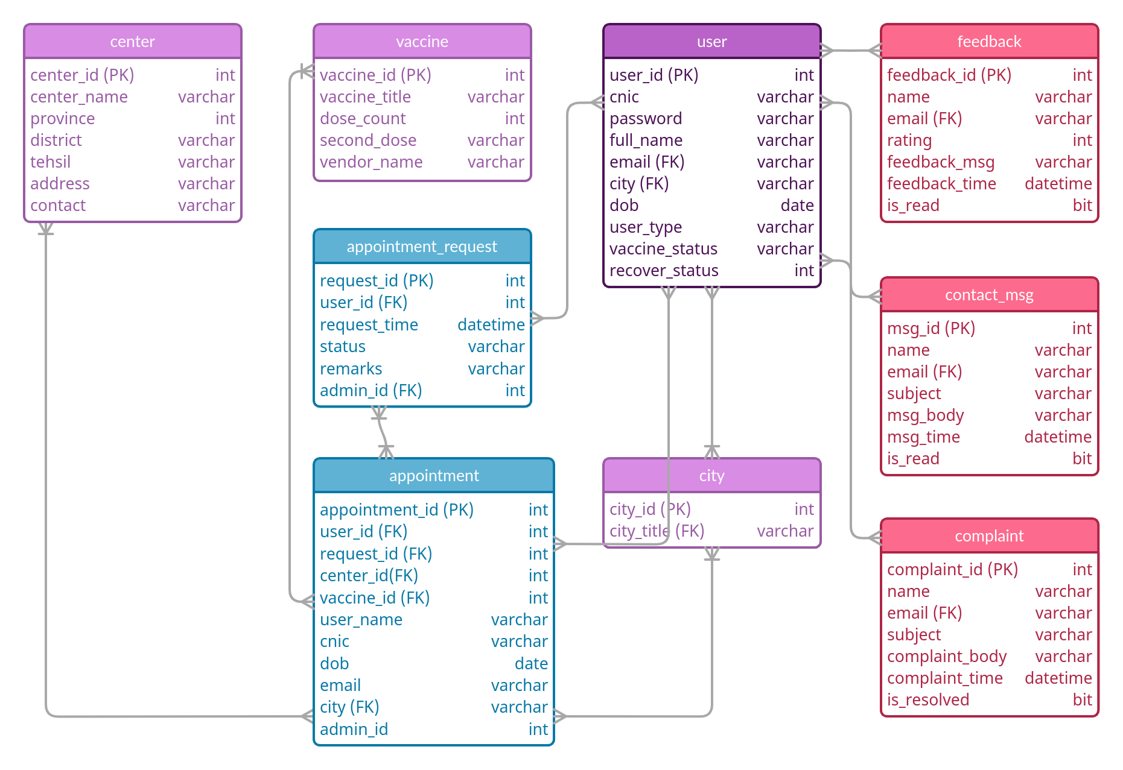
Database Diagram

Slide 15
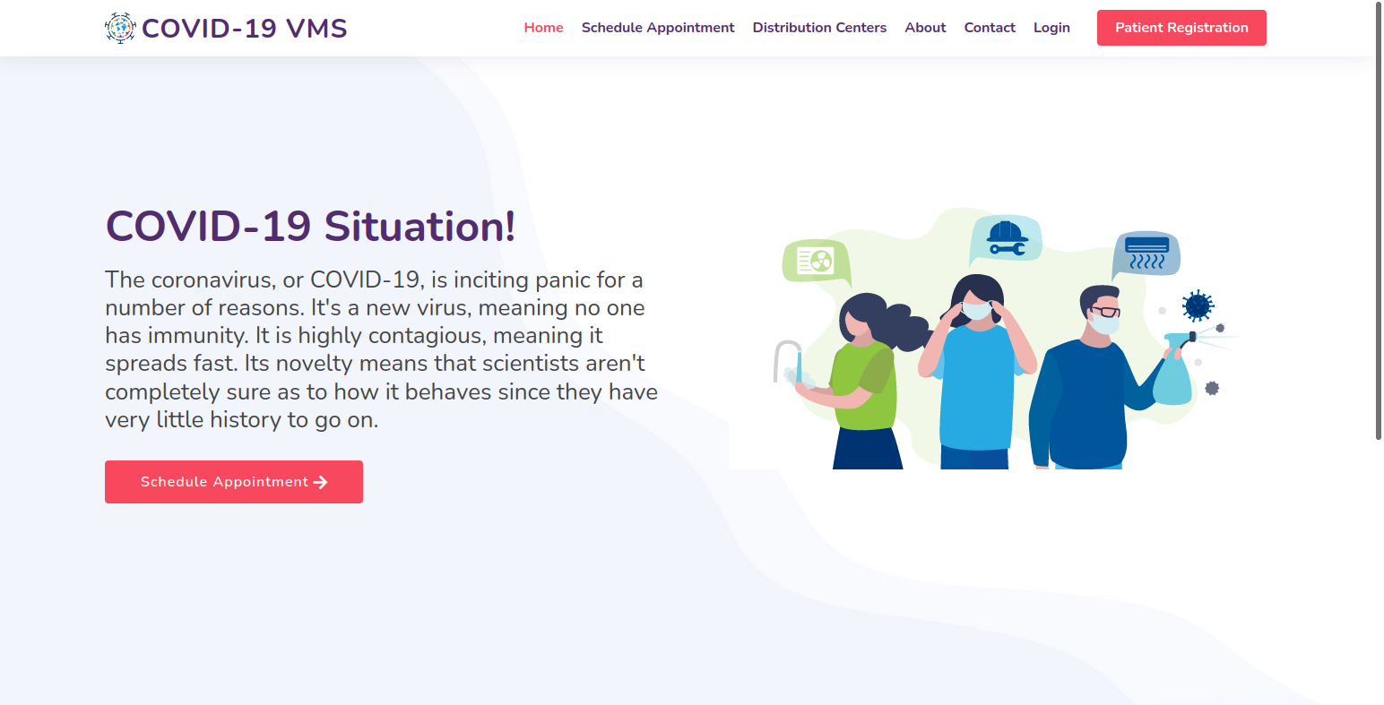
User Interfaces

Slide 16
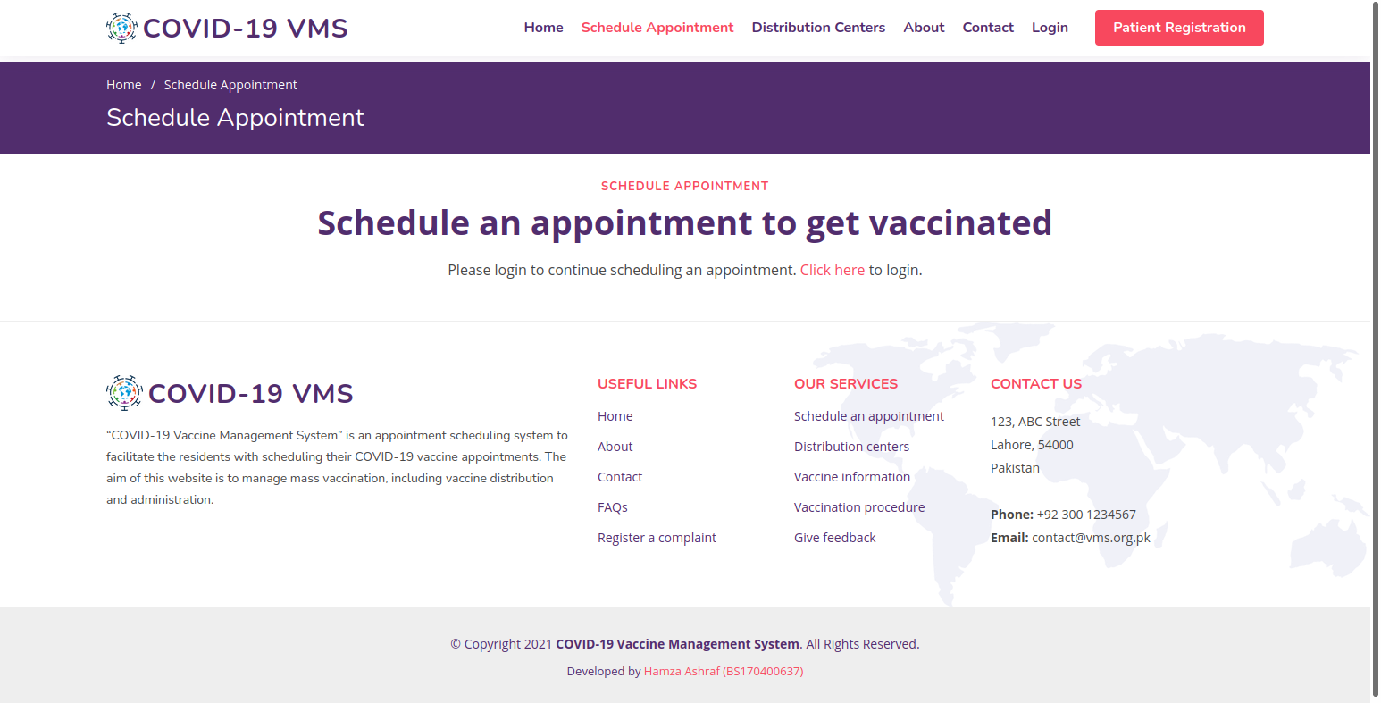
User Interfaces

Slide 17
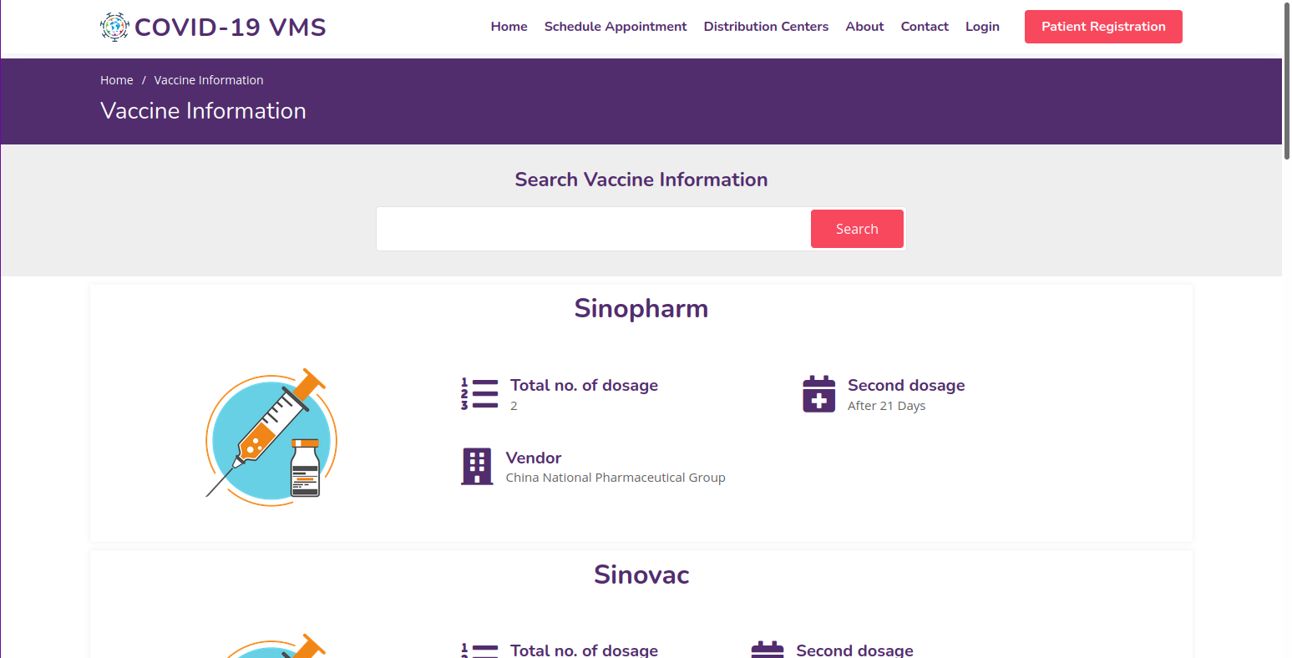
User Interfaces

Slide 18
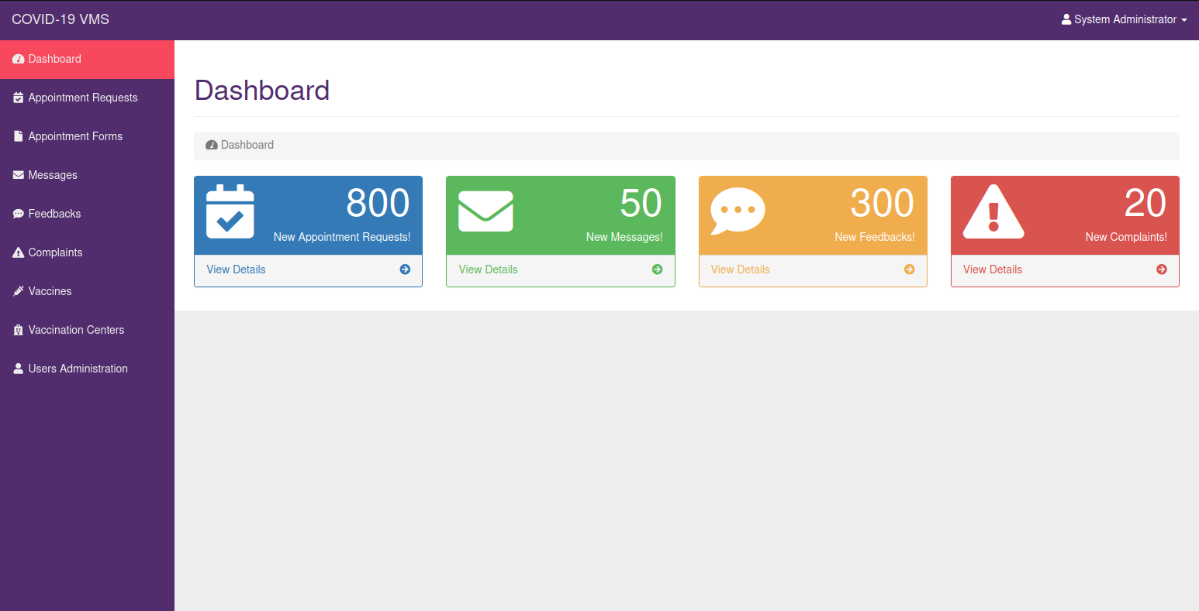
User Interfaces

Slide 19
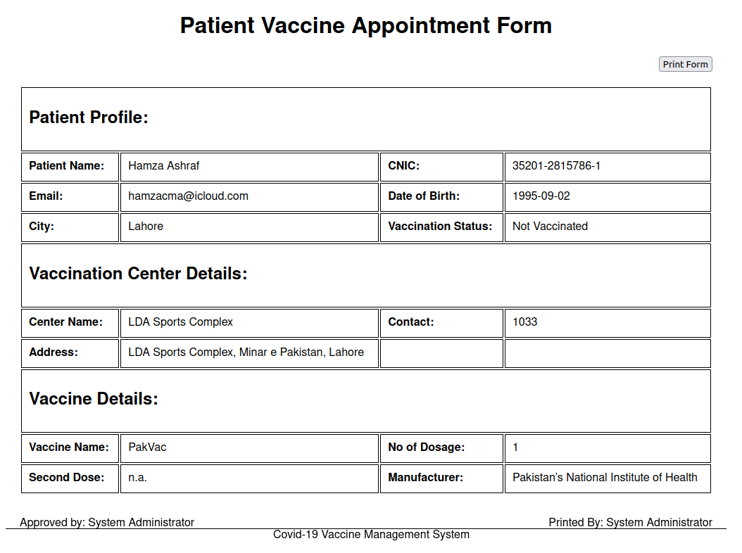
User Interfaces

Slide 20
Tools
Ubuntu 20.0.4 Focal Fosa
Apache Web Server For Linux
MySQL Database and phpMyAdmin
Atom Text Editor
Chromium Web Browser
LibreOffice (Draw, Writer and Impress)

